Slide 1
Maharaja Agrasen Institute of Technology ETCS 211 Computer Graphics & Multimedia UNIT 1
RASTER SCAN CRT DISPLAYS, RANDOM SCAN CRT DISPLAYS.

Slide 2
Refresh rate
The refresh rate is the number of times in a second that a display hardware draws the data.
Data is picked from the frame buffer Measured in Hertz (frames per second) Inadequate refresh rate results in flickering.

Slide 3
Resolution
Number of pixels per inch of an area without overlapping is called Resolution.
More the resolution, more clear is the image.
It is measured as dpi(dots per inch).

Slide 4
Color Models
There are two most common Color models :
RGB Color Model (Red-Green-Blue)
Additive model
Additive color models use light to display color
Colors perceived in additive models are the result of transmitted light
CMYK Color Model (Cyan-Magenta-Yellow-blacK)
Subtractive model
subtractive models use printing inks.
Colors perceived in subtractive models are the result of reflected light

Slide 5
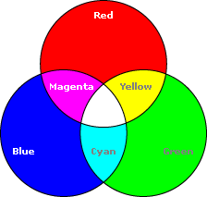
RGB Color Model
RGB Color Model:
* Additive color model.
* For computer displays.
* Uses light to display color.
* Colors result from transmitted light.
* Red + Green + Blue = White.

Slide 6
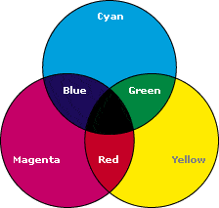
CYMK Color Model
2) CMYK Color Model:
* Subtractive color model.
* For printed material.
* Uses ink to display color.
* Colors result from reflected light.
* Cyan + Magenta + Yellow = Black.

Slide 7
Display Devices

Slide 8
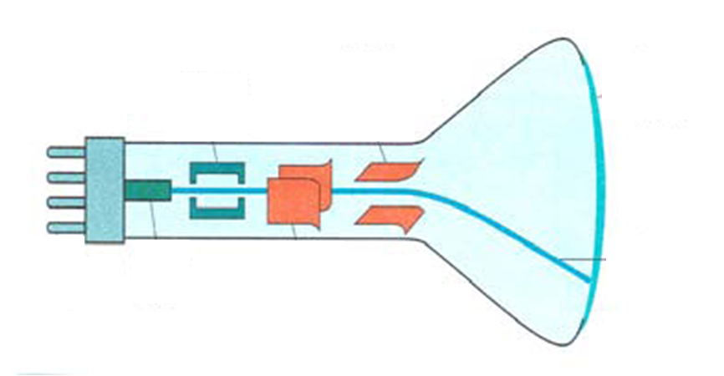
Refresh CRT
Vertical deflecting plates
Focusing system
Phosphor coated screen
Base
Electron beam
Electron gun
Horizontal deflecting plates
Connector Pins

Slide 9
Raster Scan Displays
The most common type of monitor employing a CRT is raster scan display.
In Raster scan display the electron beam is swept across the screen one row at a time from top to bottom.
Raster: A rectangular array of points or dots
Pixel: One dot or picture element of the raster. Its intensity range for pixels depends on capability of the system
Scan line: A row of pixels
Picture elements are stored in a memory called frame buffer
A special memory is used to store the image with scan-out synchronous to the raster. We call this the frame buffer
Disadvantage
Raster system produces jagged lines that are plotted as discrete points

Slide 10
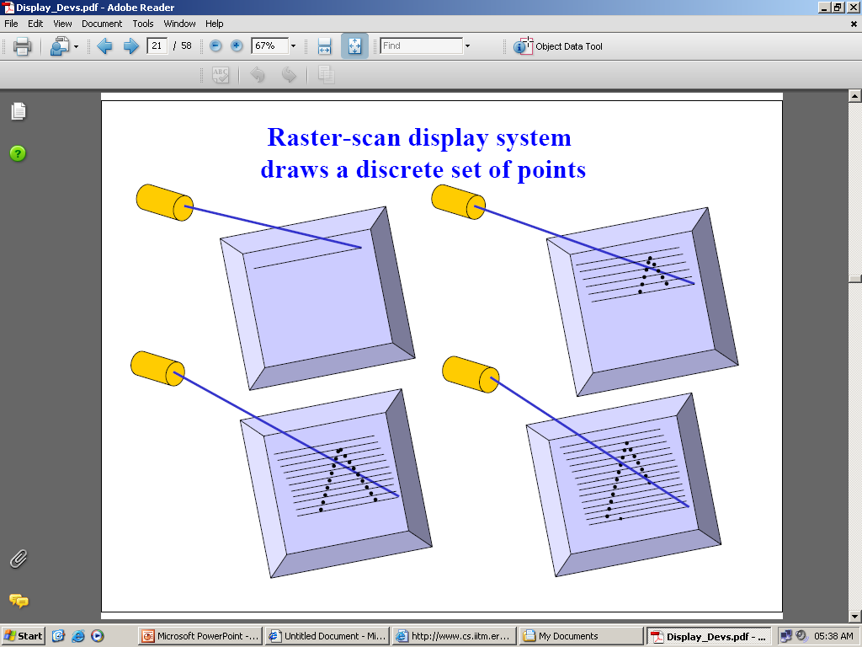
Raster Scan Displays cont..

Slide 11
Raster Scan Displays cont..
Horizontal Retrace
At the end of each scan line , the electron beam returns to the left side of the screen to begin displaying the next scan line. The return to the left of the screen , after refreshing each scan line is called horizontal retrace of electron beam.
Vertical retrace
At the end of each frame the electron beam returns to the top left corner of the screen to begin the next frame.

Slide 12
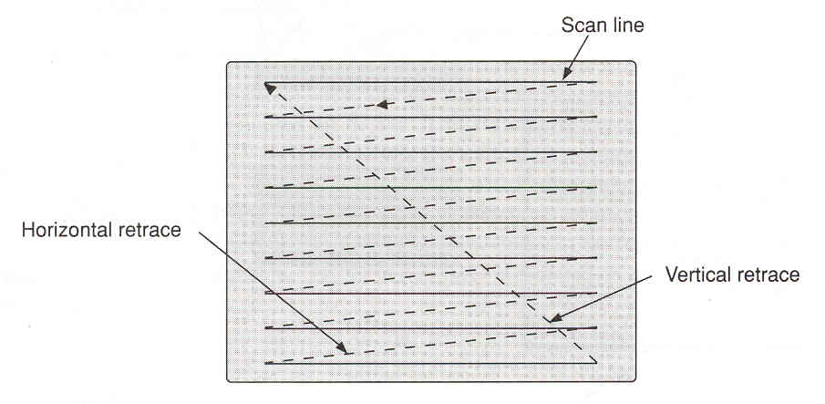
Raster Scan Displays cont..
Refresh Rate
Usually 30~75 Hz

Slide 13
Raster Scan Displays cont..
1
2
3
4
5
6
7
8
9
10
11
12
13
14
15
16
17
18
19
20
21
22
Interlacing
First, all points on the even-numbered (solid) scan-lines are displayed
Then all points along odd-numbered (dashed) lines are displayed

Slide 14
Random Scan Display
The electron beam is directed only to the parts of the screen where a picture is to be drawn.
Picture definition is stored as a set of line drawing commands in an area of memory referred to as refresh display file.
To display a specified picture ,the system cycles through a set of commands in the display file , drawing each component line after processing all lines drawing commands the s/m cycle back to the first line command in the list.
Advantage
Has high resolution since picture definition is stored as line drawing commands

Slide 15
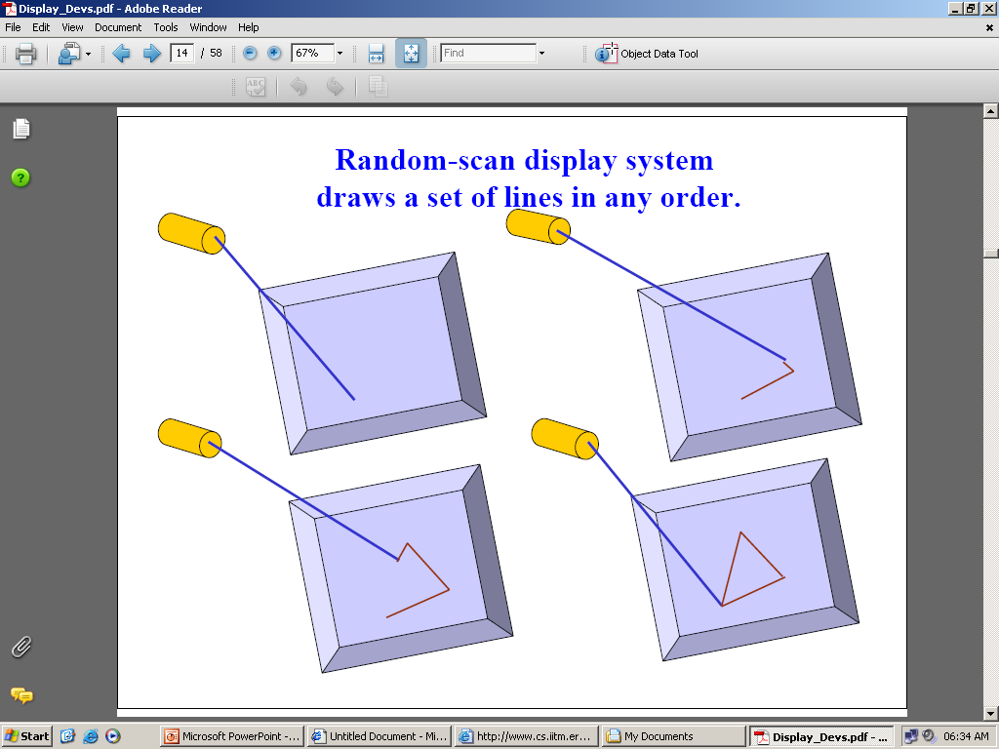
Random Scan Display cont...

Slide 16
Color CRT Monitors
2 Basic Techniques for Color Display
Beam Penetration Method
Shadow Mask Method

Slide 17
Beam-Penetration Method
Used with random scan monitors
The screen has two layers of phosphor: usually red and green
The displayed color depends on how far the electron beam penetrates through the two layers.
A beam of slow electrons excites only the outer of the red layer, a beam of fast electrons penetrates through the red layer and excites the inner green layer, and at intermediate beam speeds, combinations of the two colors are emitted to show other colors (yellow & orange)

Slide 18
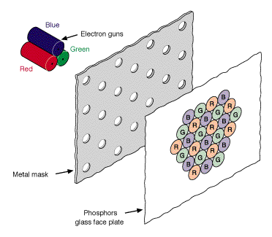
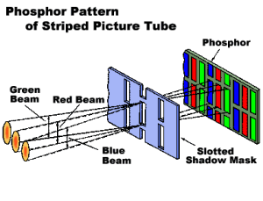
Shadow-Mask Method
Used with raster scan monitors
Three electron guns
A metal shadow mask to differentiate the beams

Slide 19
Shadow-Mask Method cont..
The Shadow mask in the previous image is known as the delta-delta shadow-mask.
The 3 electron beams are deflected and focused as a group onto the shadow mask, which contains a series of holes aligned with the phosphor-dot patterns.
The 3 beams pass through a hole in the shadow mask and activate a dot triangle, which appears as a small color spot on the screen.
A second arrangement of the 3 electron guns is in-line
Where the corresponding red-green-blue color dots on the screen are aligned along one scan – line instead of a triangular pattern.

Slide 20
Controlling Colors in Shadow mask
Different colors can be obtained by varying the intensity levels of the three electron beams.
Example: Simply turning off the red and green guns, we get only the color coming from the blue phosphor.
Yellow = Green + Red
Magenta = Blue + Red
Cyan = Blue + Green
White is produced when all the 3 guns possess equal amount of intensity.

Slide 21
Scan Conversion

Slide 22
Scan Conversion
Output Primitives
Basic geometric structures used to describe scenes.
Can be grouped into more complex structures
Example : Point, straight line segments, circles and other conic sections, polygon color areas and character strings
Construct the vector picture
Rasterization
The process of determining the appropriate pixels for representing picture or graphic object
Scan conversion
It is the final step of rasterization . It converts picture definition into a set of pixel-intensity values for storage in the frame buffer.

Slide 23
Raster Scan Displays
It is the most common method of displaying images on the CRT screen.
The electron beam sweeps across the screen, one row at a time from top to bottom.
The image is displayed by how each pixel is intensified.
The image to be displayed is stored in the frame buffer in the form of intensity values for each pixel.

Slide 24
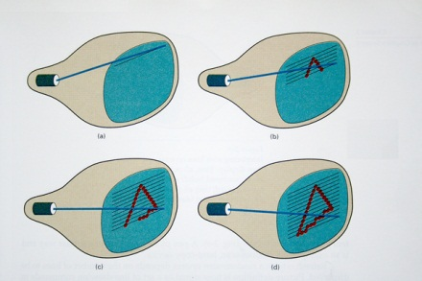
Raster Scan Displays

Slide 25
Raster Scan Displays
These intensity values are then retrieved from the refresh buffer and painted on the screen one row at a time.
In simple black and white systems, only one bit per pixel is needed to control the intensity of screen points.
1 indicates electron beam is turned on
0 indicates electron beam is turned off

Slide 26
Raster Scan Displays
For color systems there are 24 bits per pixel.
Therefore, color systems have larger sized frame buffer (3 MB).
For black and white system frame buffer is called bitmap and for color systems it is called pixmap.

Slide 27
Raster Scan Displays
Horizontal retrace: After sweeping across each row (scan line), the electron beam returns to the left of the screen to start displaying the next scan line or row. This is called horizontal retrace.
Vertical retrace: the electron beam returns to the top left corner of screen to begin the next frame when it completes one frame. This is called vertical retrace.

Slide 28
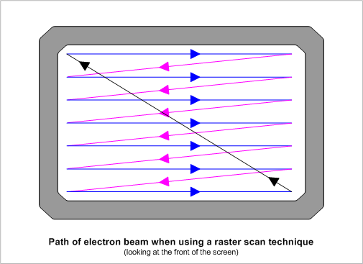
Raster Scan Displays

Slide 29
Raster Scan Displays
Refresh rate: it means how many times the screen is redrawn or refreshed in one second. Refresh rate in the raster scan systems is between 60 to 80 Hz per second.
Interlaced Scanning: in this alternate lines are scanned instead of all lines. Scanning is done in two passes.
Advantage: We can see the entire screen displayed in half time.

Slide 30
Random Scan Displays
In these systems, the electron beam does not sweep each and every row, however, it is directed only to the parts of the screen where a picture is to be drawn.
Also known as vector displays.
Draws one line at a time.
Parts of the picture can be displayed in any order.

Slide 31
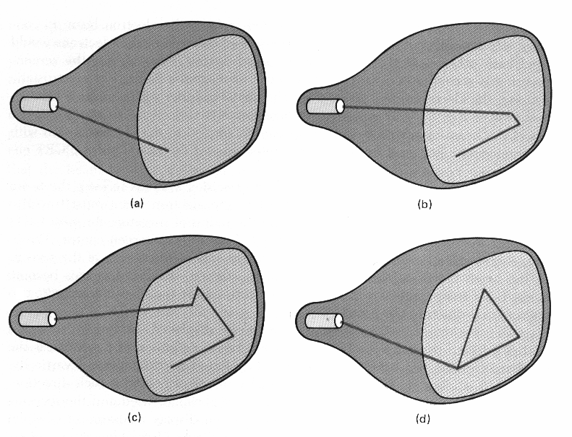
Random scan systems

Slide 32
Random scan systems
In these systems, the refresh buffer does not store the intensity values of the picture, but a set of line drawing commands.
Refresh buffer is also called display file.
The system cycles through the set of commands in the display file to display a picture.
Refresh rate in random scan systems is 30 to 40 times per second.

Slide 33
Difference between Raster Scan and Random Scan systems
RASTER SCAN
RANDOM SCAN
It is a point plotting device.
It sweeps in a particular order.
It is well suited for realistic display of scenes containing shading and color patterns.
It is used for photos. That is why Photoshop is a raster editing program.
It is a line drawing device.
It draws the image in any order.
It is used for line drawing applications and cannot display realistic shaded scenes.
It is used for text, logos, letterheads.

Slide 34
Important Properties of Display Devices
Resolution
Resolution of a display device is defined as the number of pixels on the entire screen of the device.
For example, 1024 X 768 resolution means,
The screen has 1024 pixels in each line and
The screen has 768 horizontal lines.

Slide 35
2. Persistence
It is the property of phosphor that is how long they continue to emit light.
Persistence is defined as the time it takes the emitted light to decay to one-tenth of its original intensity.
Computer monitors have persistence of 10-60 microseconds.
Lower persistence phosphor requires higher refresh rates to maintain a picture on the screen without flicker.

Slide 36
Questions based on lecture-3
Q-1 Types of computer graphics are a. Vector and raster b. Scalar and raster c. Vector and scalar d. None of these
Q-2 Vector graphics is composed of a. Pixels b. Paths c. Palette d. None of these
Q-3. Raster graphics are composed of a. Pixels b. Paths c. Palette d. None of these

Slide 37
Q-4Raster images are more commonly called a. Pix map b. bitmap c. both a & b d. none of these
Q-5. Pixel can be arranged in a regular a. One dimensional grid b. Two dimensional grid c. Three dimensional grid d. None of these
Q-6. The brightness of each pixel is a. Compatible b. Incompatible c. Both a & b d. None of these
Q-7. Each pixel has ________basic color components a. Two or three b. One or two c. Three or four d. None of these

